Slide 1
CLOUDERA
HANDS-ON
EXPERIENCE
Data Lifecycle

Slide 2
AGENDA
Welcome -
Introductions
Workshop Environment
Lab Introduction
Labs

Slide 3
INTRODUCTIONS

Slide 4
WHO WE ARE
Notes:
Additional slides added by Brendan Moran
When there is not access to a Webinar, then a Meeting Room may also suffice. They have slightly different features and functionality such as Co-Hosts and Breakout rooms

Slide 5

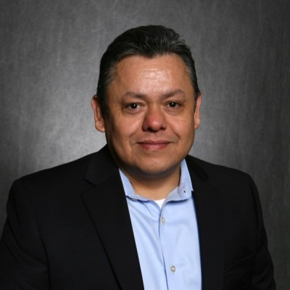
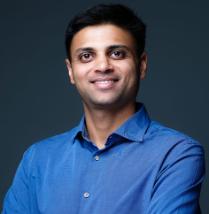
CLOUDERA TEAM
Meet the Cloudera team
Workshop Leads
Ali Bajwa
Sr. Director Partner Solution Engineering
abajwa@cloudera.com
Salvador Almazan
Sr. Partner Solutions Engineer
salmazan@cloudera.com
Anshul Gupta
Partner Solutions Engineer
angupta@cloudera.com
Notes:
Read slide
------
The app we ultimately build will be an API that can predict the likelihoodof a flight being cancelled based on historic flight data.
Cloudera ML on CDP Public cloud, with AWS as our underlying cloud vendor.
The things we do today you’ll be able to apply to your CDSW instance to start running and deploying ML models and applications and ultimately you one day may be similar things in your public cloud Cloudera Machine Learning instances

Slide 6
LOGISTICS
Wifi
Toilettes
Break/lunch

Slide 7
WHO ARE YOU?
Name
Company
Role/function

Slide 8
AGENDA
09:30 Check-in 10:00 Welcome / Introductions 10:20 Workshop Introduction 10:45 Data Ingestion Hands-on Lab 11:30 Engineering Hands-on Lab 12:30 Break 1:30 Data Warehouse Hands-on Lab 2:15 Machine Learning Application Hands-on Lab 3:30 Q&A & Closing

Slide 9
CLOUDERA
PUBLIC
CLOUD

Slide 10
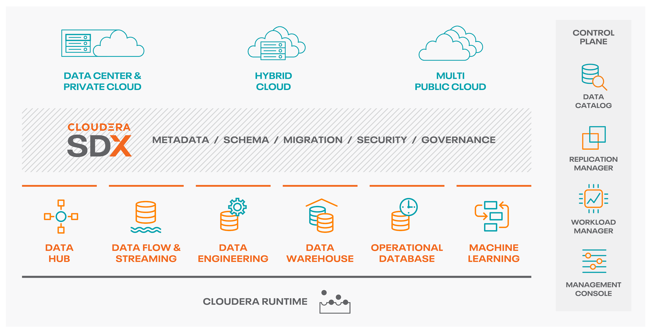
CLOUDERA DATA PLATFORM
View one pane of glass across hybrid and multi-clouds
Scale to petabytes of data and 1,000s of diverse users
Control cloud costs with auto scale, suspend and resume
Optimize workloads based on analytics and machine learning
Inspect data lineage across clouds and clusters
altus
data plane service

Slide 11



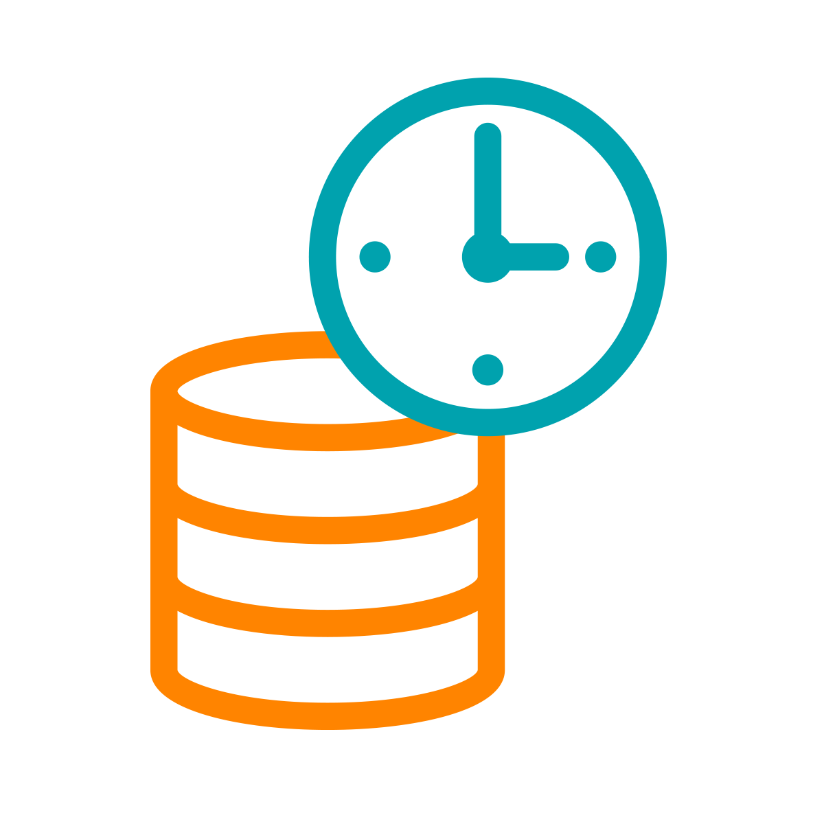
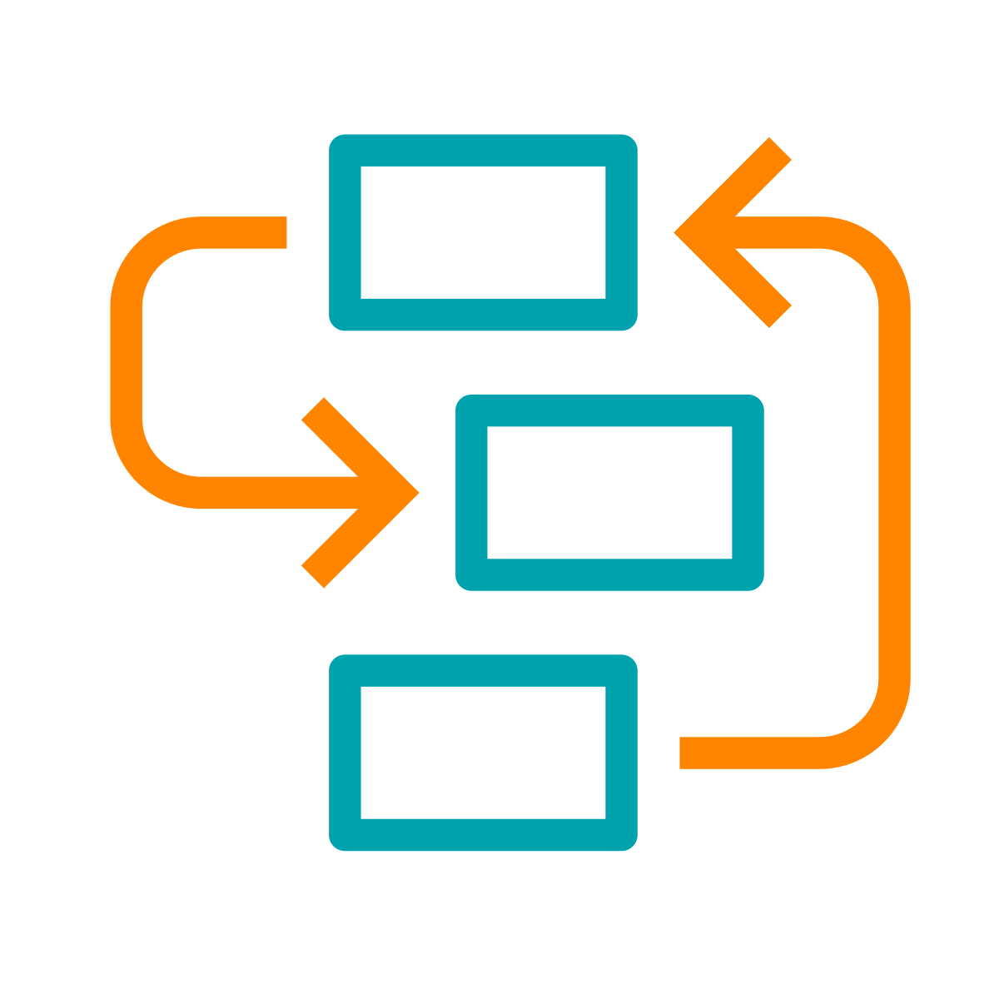
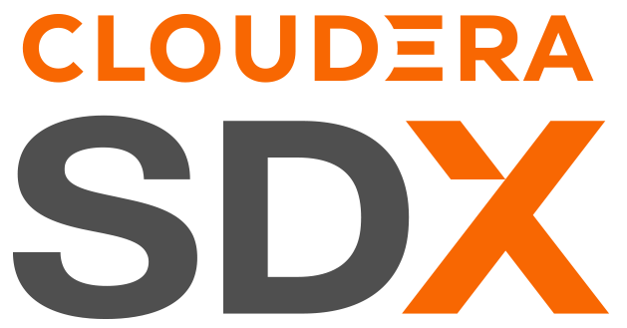

CDP PUBLIC CLOUD
CDP Public Cloud
Analytic Experiences
Ideal for new apps, bursty workloads and demanding users
Easier to operate, 10x faster
Auto scale, suspend and resume
Better analytics user experience, outperforms shadow IT
Data Services
MANAGEMENT CONSOLE
DATA CATALOG
REPLICATION MANAGER
WORKLOAD
MANAGER
Cloud-native architecture with containerized Experiences and Base cluster foundation
Admin and user experience is consistent across CDP Private & CDP Public for true hybrid cloud
DF
DE
DW
OD
ML
K8S Containers - EKS, AKS, etc.
Data Hub
Storage management and SDX for Analytic Experiences
Supports existing apps and traditional workloads with Data Hub
Data Hub offers cluster management for Flow, Streaming, Data Engineering, Data Warehouse & Operational Database
Data Hub
DATA
HUB
OBJECT STORE S3 | ADLS | CS
Virtual Servers

Slide 12
KEY TECHNOLOGIES FOR THE DATA LIFECYCLE
Machine Learning
Collaborative ML workspaces for data scientists to develop, experiment and deploy models into production with secure, self-service enterprise data access
DataFlow & Streaming
Scalable, real-time streaming platform to ingest, curate, and analyze data with an easy no-code approach to developing sophisticated streaming applications easily
Data Engineering
Schedule, monitor, and debug data pipelines to streamline ETL processes quickly and securely with built-in job scheduling and troubleshooting
Data Warehouse
Deploy easy-to-use data warehouses with high performance SQL engines for teams of business analysts that need sub-second query response times on petabyte scale data
Data
Visualization
Curate fast, self-service dashboards, reports and charts to easily and quickly develop and share agile analytical insight across your business
Operational Database
High-performance NoSQL database with unparalleled scale and performance for business critical operational applications
Easily manage data clusters across the data lifecycle running Apache Spark, Hive, Impala, HBase, Phoenix, NiFi, Kafka, Flink, and more
Shared Data Experience
Security, governance and metadata technologies that reduce security risks and operational costs through central policy controls that are automatically enforced across analytics in public and private clouds
Data Hub

Slide 13


BENEFITS OF CDP PUBLIC CLOUD
Simplify Data Analytics
You Own Your Data
First Class Security
Hybrid Flexibility
Common Skill Set
Data Lifecycle
Easy and Portable
Notes:
CDP is PaaS:
CDP is an automated PaaS platform
Pain free automated deployment and destruction of secured clusters integrated with your environment
Significantly reduce admin overheads with automation and goverance tooling
Patching / Upgrades and enhancements all done by Cloudera
No lock-step upgrades - multiple versions running at once in different clusters
Data in your VPC:
All data stays in your VPC - this is a theme because it is not the case with competition
We never move it or touch it !
One data set for all functions on the platform - no data silos
Own relationship with cloud vendor
Integrated security
Consistent Security and Governance
Set once at an environment level, inherited by all use case.
Full integrated and out of the box
Hybrid Flexibility:
Cloudera Runtime
Move the workloads that are right for cloud
Deliver onprem capability via Private cloud
Gives you flexibility and choice
Can start developing and testing in the cloud, and bring back on prem later if needed - same tech everywhere
Same Skill Set
Use the same skills developed on prem in the cloud - we have made it easier to manage and consume but same underlying tech
No need to re-skill in new tools
Instantly start delivering value in CDP
Multi-Function
Rich Multifuncion capabilities
Flexibility and choice of Datahub
Cloud native experiences with DW and ML including autoscale and kubernetes
All on same underlying data in your VPC
Easy Migration
Inbuilt tools provide easy migration path
Move data, metadata and security via replication manager
Not big bang conversion required - derisks

Slide 14
WORKSHOP
ENVIRONMENT

Slide 15
CONNECTING TO LAB ENV
Repo:
https://github.com/campossalex/ClouderaMadrid
Authenticate using assigned user id
1st Step: change your Workload Password

Slide 16
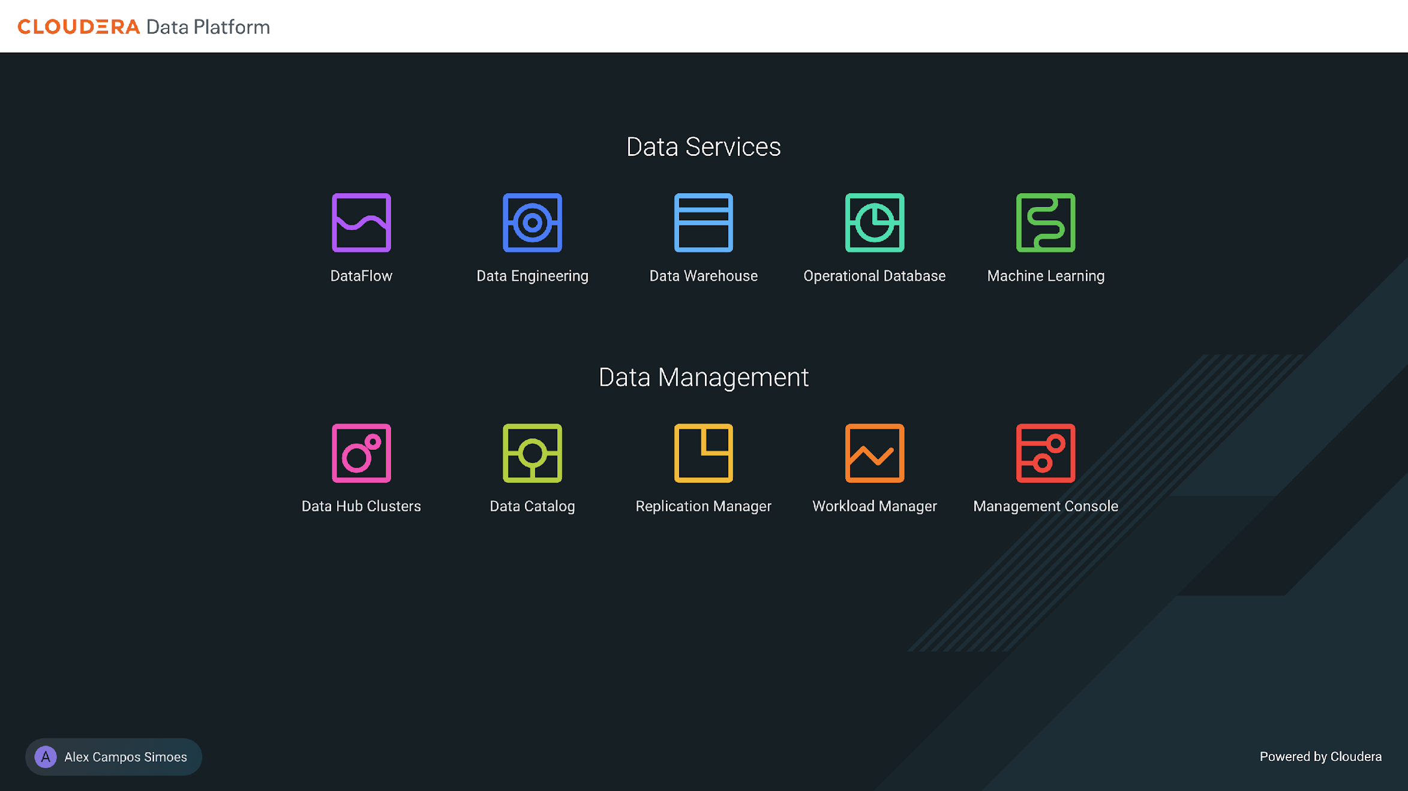

Slide 17
LAB
INTRODUCTION

Slide 18

CUSTOMER
CHURN

Slide 19
TODAY’S EXPECTATIONS
Data Lifecycle
Ingest real time data to an Open Lakehouse
Run Data Engineering transformation
Query/explore data and build Data Viz applications
Train and deploy a ML model to predict customer churn
Explore real-time scoring in a web app powered by CML

Slide 20








ANALYTICS ACROSS THE DATA LIFECYCLE
DATA ENGINEERING
MACHINE LEARNING
INGEST
ANALYZE
PUBLISH
02
04
01
03
05
PREPARE
PREDICT
DATA FLOW
DATA
WAREHOUSE
DATA VISUALIZATION
Data
Viz

Slide 21
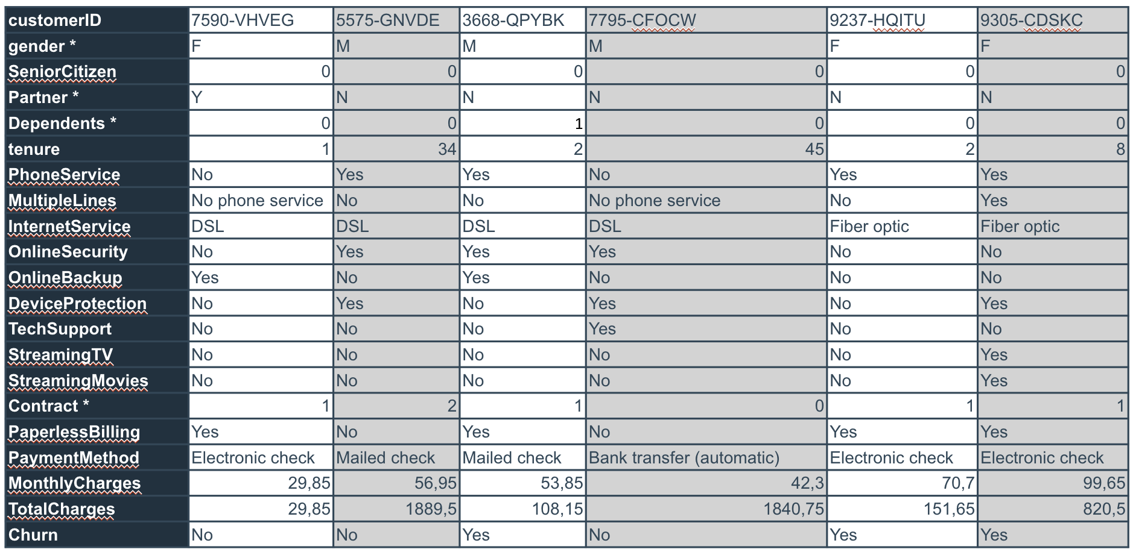
SOLUTION DESIGN TO ANALYZE & PREDICT TELCO CHURN
INGEST
PREPARE
PREPARE
Ingest from Kafka, store in S3 using Parquet in the Open Lakehouse
Orchestrate jobs to enrich data and update table
Train and deploy ML model to predict telco churn
Telco Customer Data collected in Kafka
ANALYZE
PUBLISH
Query data from Open Lakehouse
Build a dashboard/ visual analytics
SECURITY | GOVERNANCE | LINEAGE | MANAGEMENT | AUTOMATION

Slide 22
DATA SOURCE
customerID | 7590-VHVEG | 5575-GNVDE | 3668-QPYBK | 7795-CFOCW | 9237-HQITU | 9305-CDSKC
gender * | F | M | M | M | F | F
SeniorCitizen | 0 | 0 | 0 | 0 | 0 | 0
Partner * | Y | N | N | N | N | N
Dependents * | 0 | 0 | 1 | 0 | 0 | 0
tenure | 1 | 34 | 2 | 45 | 2 | 8
PhoneService | No | Yes | Yes | No | Yes | Yes
MultipleLines | No phone service | No | No | No phone service | No | Yes
InternetService | DSL | DSL | DSL | DSL | Fiber optic | Fiber optic
OnlineSecurity | No | Yes | Yes | Yes | No | No
OnlineBackup | Yes | No | Yes | No | No | No
DeviceProtection | No | Yes | No | Yes | No | Yes
TechSupport | No | No | No | Yes | No | No
StreamingTV | No | No | No | No | No | Yes
StreamingMovies | No | No | No | No | No | Yes
Contract * | 1 | 2 | 1 | 0 | 1 | 1
PaperlessBilling | Yes | No | Yes | No | Yes | Yes
PaymentMethod | Electronic check | Mailed check | Mailed check | Bank transfer (automatic) | Electronic check | Electronic check
MonthlyCharges | 29,85 | 56,95 | 53,85 | 42,3 | 70,7 | 99,65
TotalCharges | 29,85 | 1889,5 | 108,15 | 1840,75 | 151,65 | 820,5
Churn | No | No | Yes | No | Yes | Yes
* Attributes to be enriched

Slide 23
LAB
1

Slide 24
ANALYTICS ACROSS THE DATA LIFECYCLE
DATA ENGINEERING
MACHINE LEARNING
INGEST
ANALYZE
PUBLISH
02
04
01
03
05
PREPARE
PREDICT
DATA FLOW
DATA
WAREHOUSE
DATA VISUALIZATION
SECURITY | GOVERNANCE | LINEAGE | MANAGEMENT | AUTOMATION

Slide 25
LAB 1 – OVERVIEW
CDF tour
Configure and deploy a NiFi Flow from Catalog, to ingest data from Kafka topic to Open Lakehouse
Execute the Flow pipeline

Slide 26
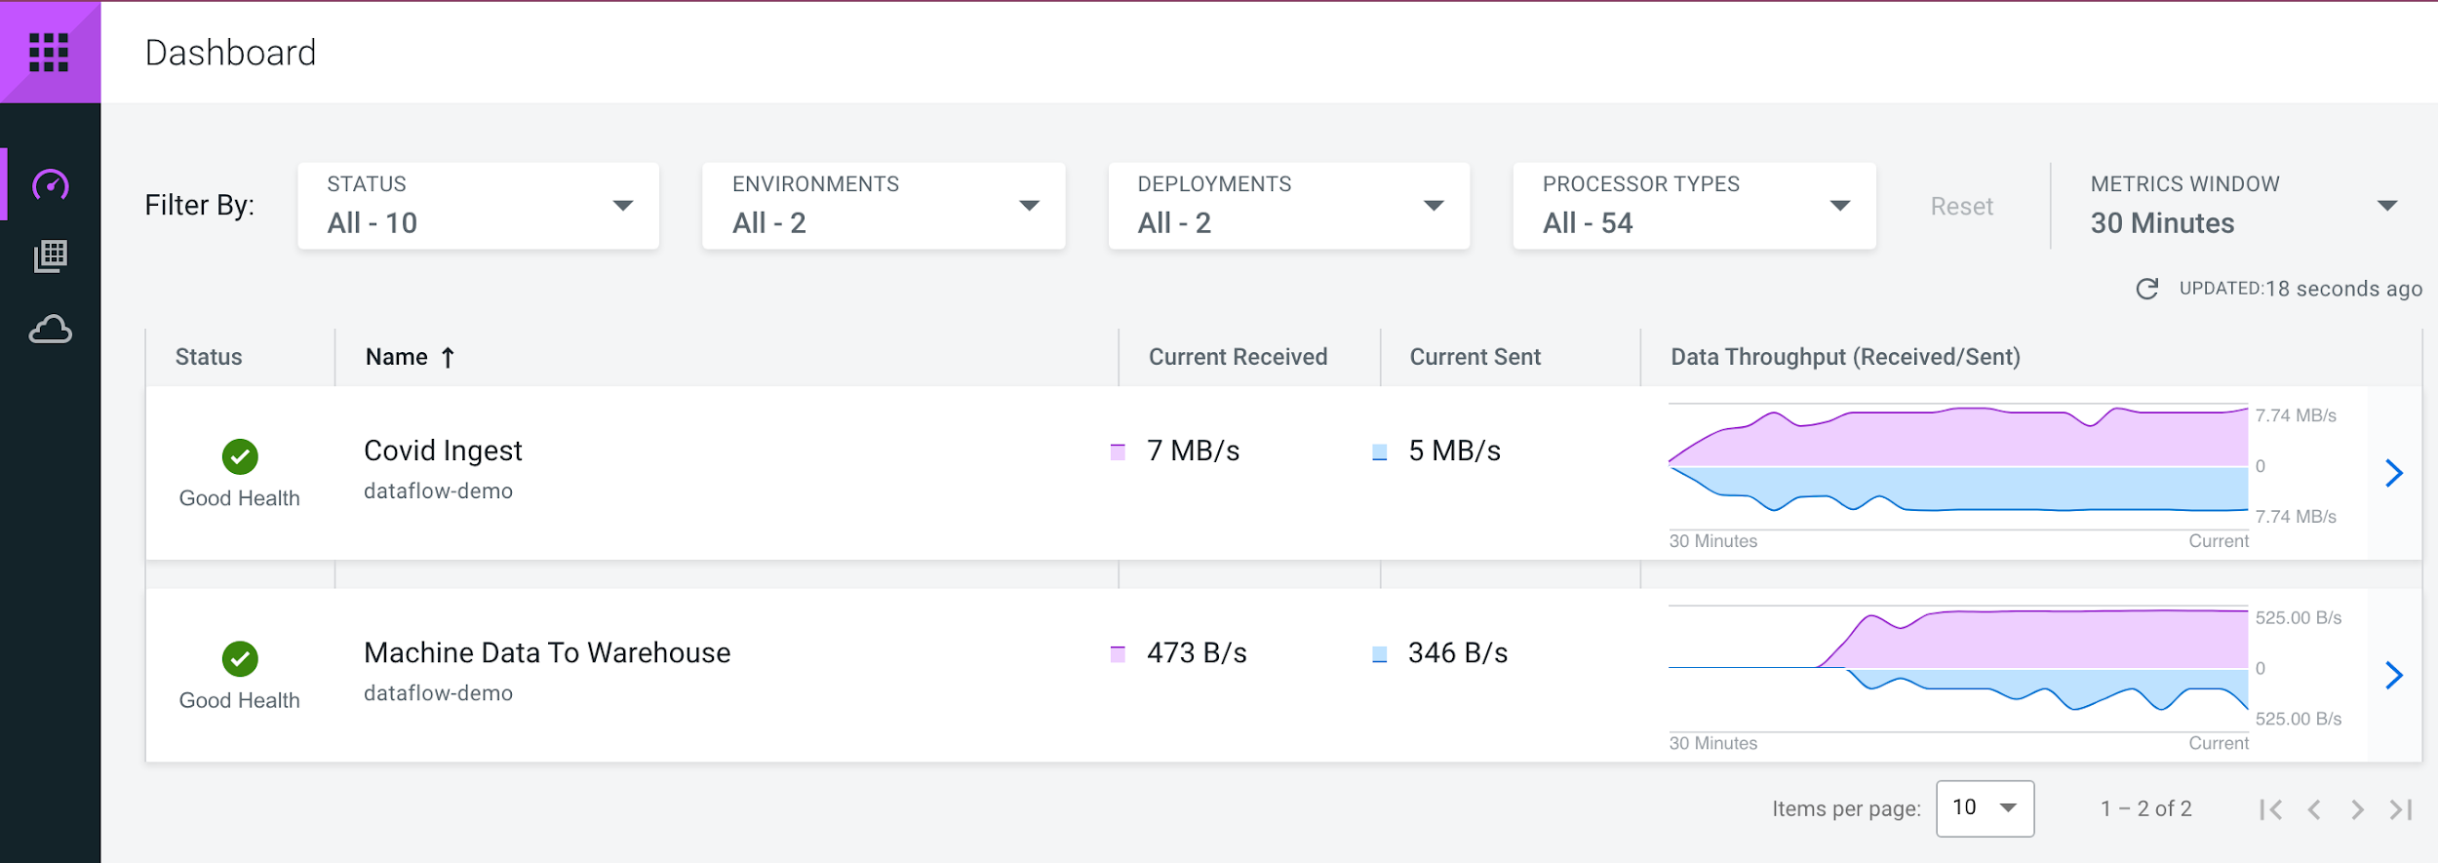
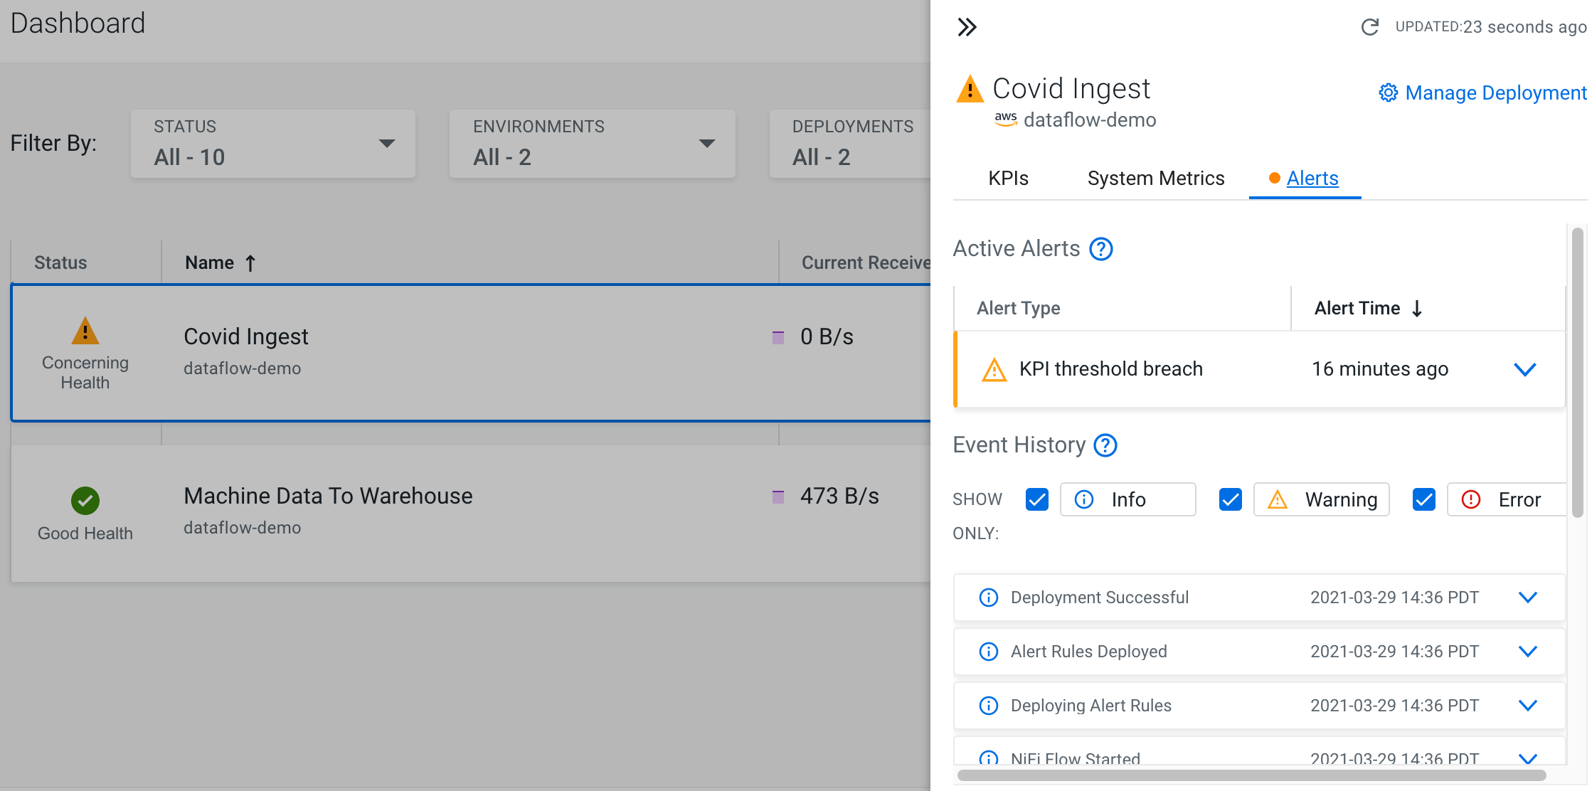
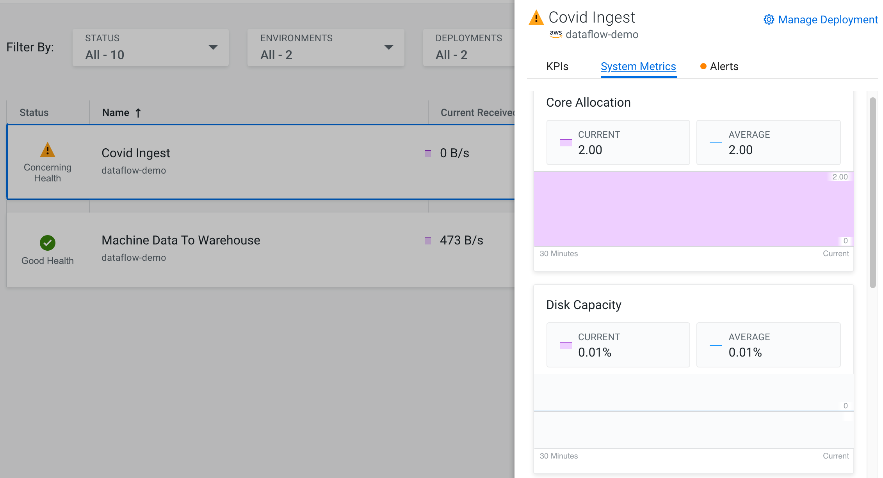
DATA FLOW
Easy Flow deployment
Auto-scaling, resource isolation and cost-optimization
Flow Catalog, central repository for flow definitions
ReadyFlow Gallery, cover most common data flow use cases
Easy maintenance/upgrades
Advance monitoring capabilities
Multiple data sources and sink operations

Slide 27
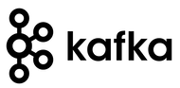
LAB 1 – COMPONENTS
A streaming message platform. It is designed to be high performance, highly available, and redundant, ideal for real-time and streaming applications

Slide 28

LAB 1 – COMPONENTS
Apache NiFi is an open source software for automating and managing the flow of data between systems. It is a powerful and reliable system to process and distribute data. It provides a web-based User Interface for creating, monitoring, & controlling data flows.
Some of the features includes data provenance, extensible, secure and others.

Slide 29
LAB
2

Slide 30
ANALYTICS ACROSS THE DATA LIFECYCLE
DATA ENGINEERING
MACHINE LEARNING
INGEST
ANALYZE
PUBLISH
02
04
01
03
05
PREPARE
PREDICT
DATA FLOW
DATA
WAREHOUSE
DATA VISUALIZATION
SECURITY | GOVERNANCE | LINEAGE | MANAGEMENT | AUTOMATION

Slide 31
LAB 2 – OVERVIEW
CDE tour
Configure and deploy Spark job to prepare the data

Slide 32
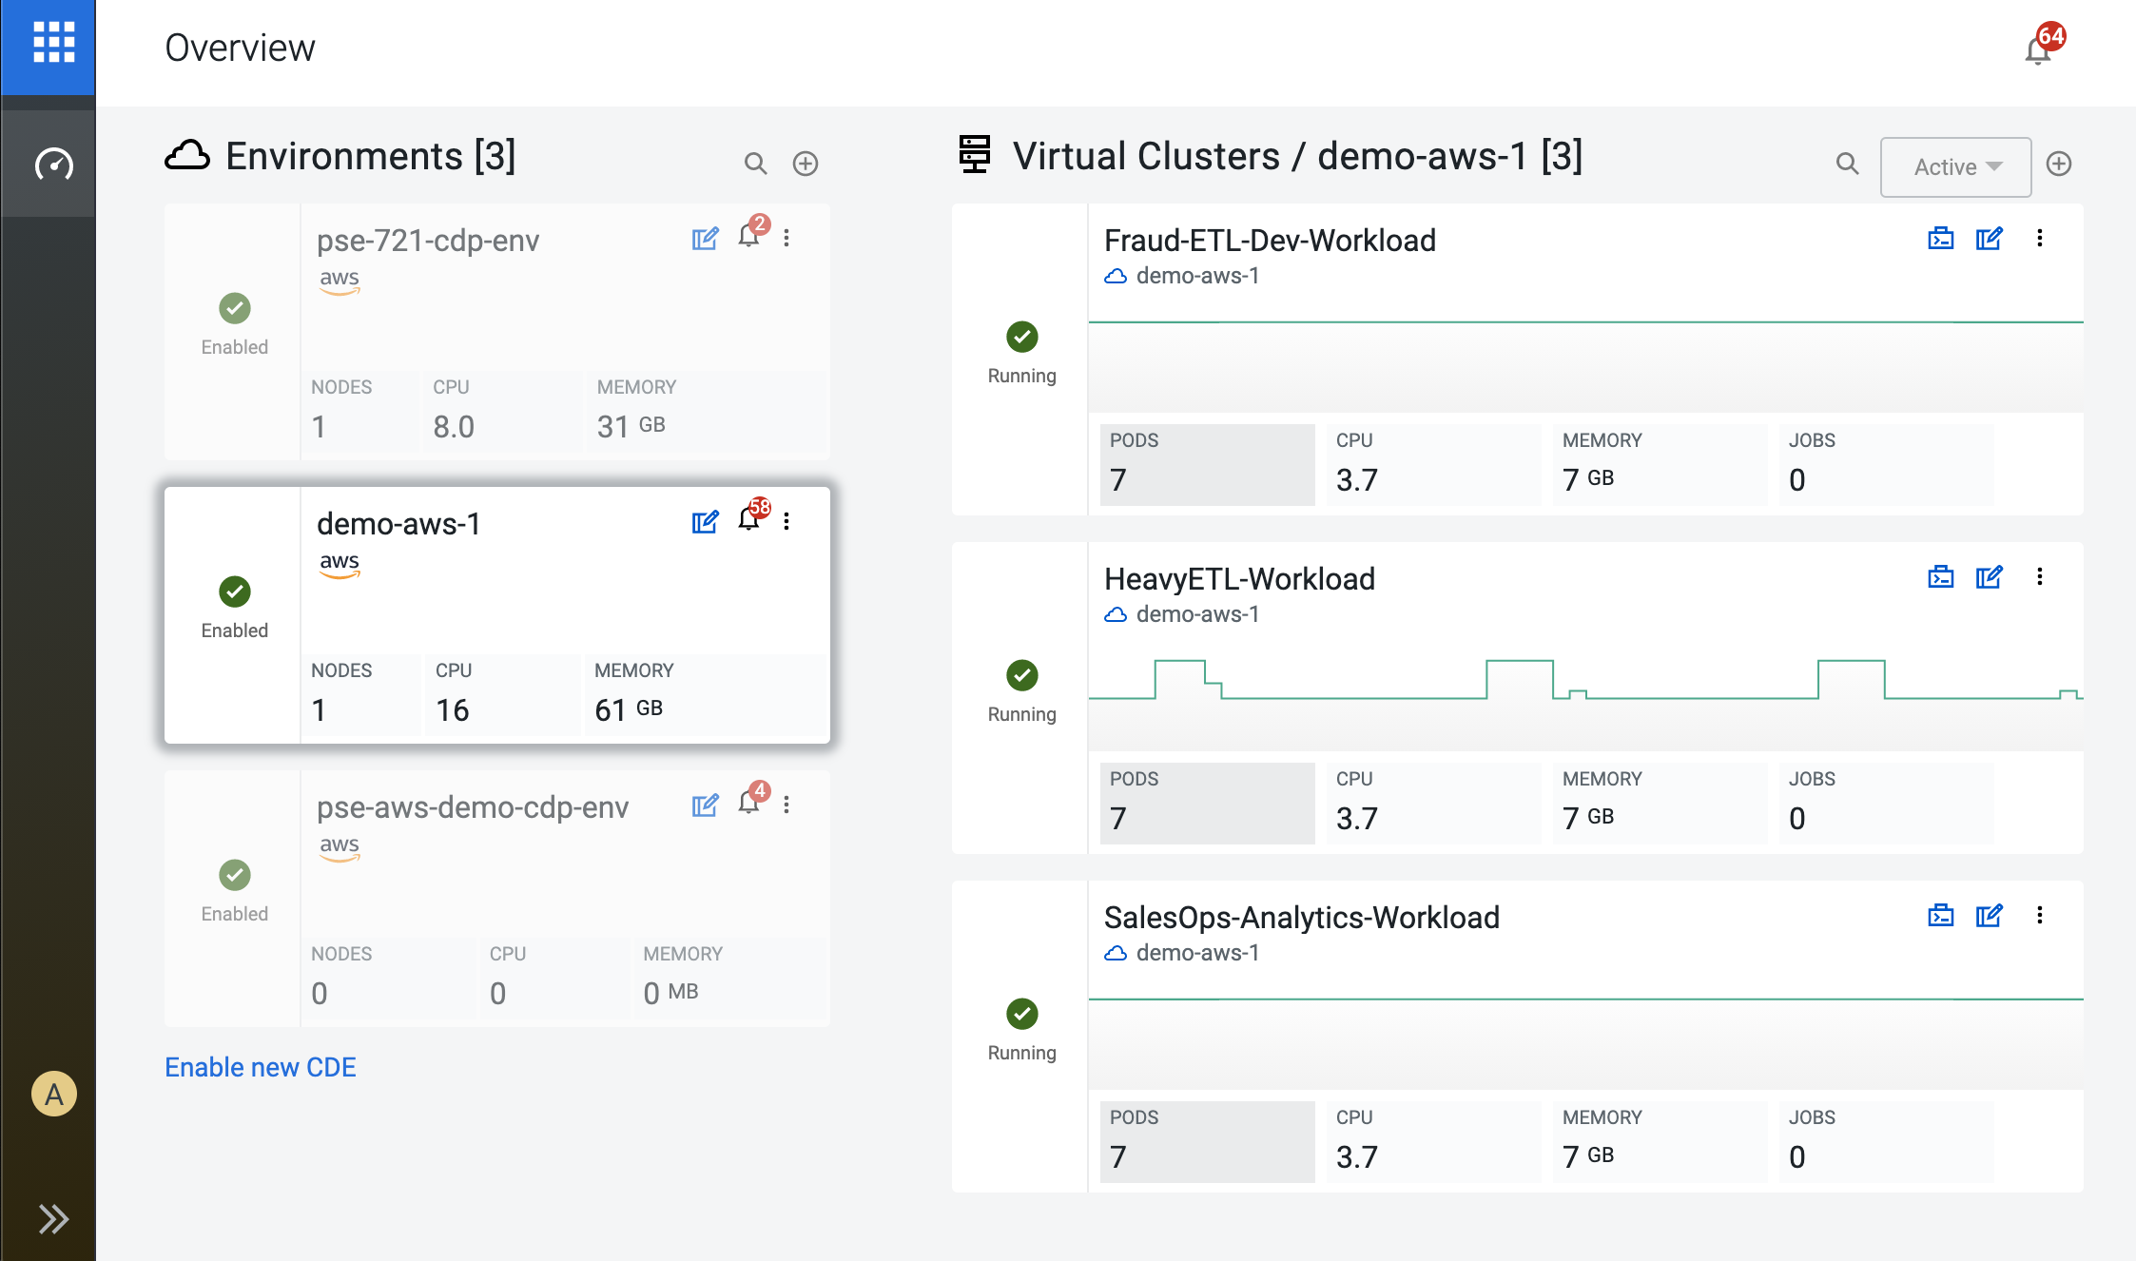
DATA ENGINEERING
Streamlined service for scheduling, monitoring, debugging, and promoting data pipelines quickly & securely
Inherited governance
Deliver data pipelines to other CDP services (CDW, CML, etc)
Portable and flexible
Complete Data pipeline management

Slide 33
LAB 2 – COMPONENTS
Apache Spark is an open-source, distributed processing system used for big data workloads. It utilizes in-memory caching, and optimized query execution for fast analytic queries against data of any size. It provides development APIs in Java, Scala, Python and R, and supports code reuse across multiple workloads—batch processing, interactive queries, real-time analytics, machine learning, and graph processing.
Open-source platform for developing, scheduling, and monitoring batch-oriented workflows. Airflow's extensible Python framework enables you to build workflows connecting with virtually any technology. A web interface helps manage the state of your workflows.

Slide 34
LAB
3

Slide 35
ANALYTICS ACROSS THE DATA LIFECYCLE
DATA ENGINEERING
MACHINE LEARNING
INGEST
ANALYZE
PUBLISH
02
04
01
03
05
PREPARE
PREDICT
DATA FLOW
DATA
WAREHOUSE
DATA VISUALIZATION
SECURITY | GOVERNANCE | LINEAGE | MANAGEMENT | AUTOMATION

Slide 36
LAB 3 – OVERVIEW
CDW tour
Query data from Open Lakehouse
Build a dashboard

Slide 37
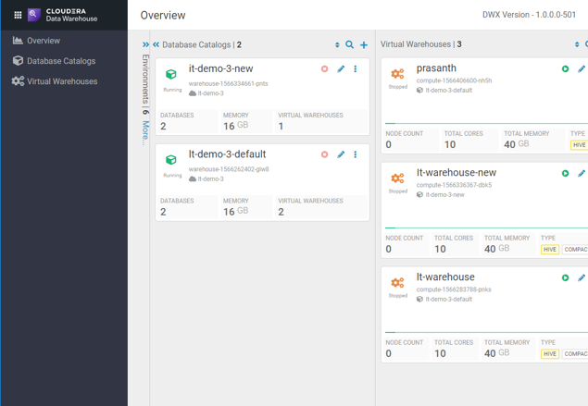
DATA WAREHOUSE
Automated Capacity Planning
Ease of Provisioning
Auto-Scaling
Resource Isolation
High Concurrency
Infrastructure optimized for Performance
Choice of two DW engines: Hive and Impala, now Unified Analytics
Fully integrated with Iceberg

Slide 38


LAB 3 – COMPONENTS
Hue is the open-source analytics workbench designed for fast data discovery, intelligent query assistance, and seamless collaboration. Bridge the gap between IT and the business for trusted self-service analytics.
Impala provides high-performance, low-latency SQL queries on data storage layer. The fast response for queries enables interactive exploration and fine-tuning of analytic queries.

Slide 39

LAB 3 – COMPONENTS
DATA WAREHOUSE
Highly curated
Precise
Complete
Well governed
DATA LAKE
Varying curation
Degrees of accuracy
Semi, unstructured
High granularity
LAKEHOUSE
Explore and discover
Trends and statistics
Predict and learn
Rapid time to insight

Slide 40
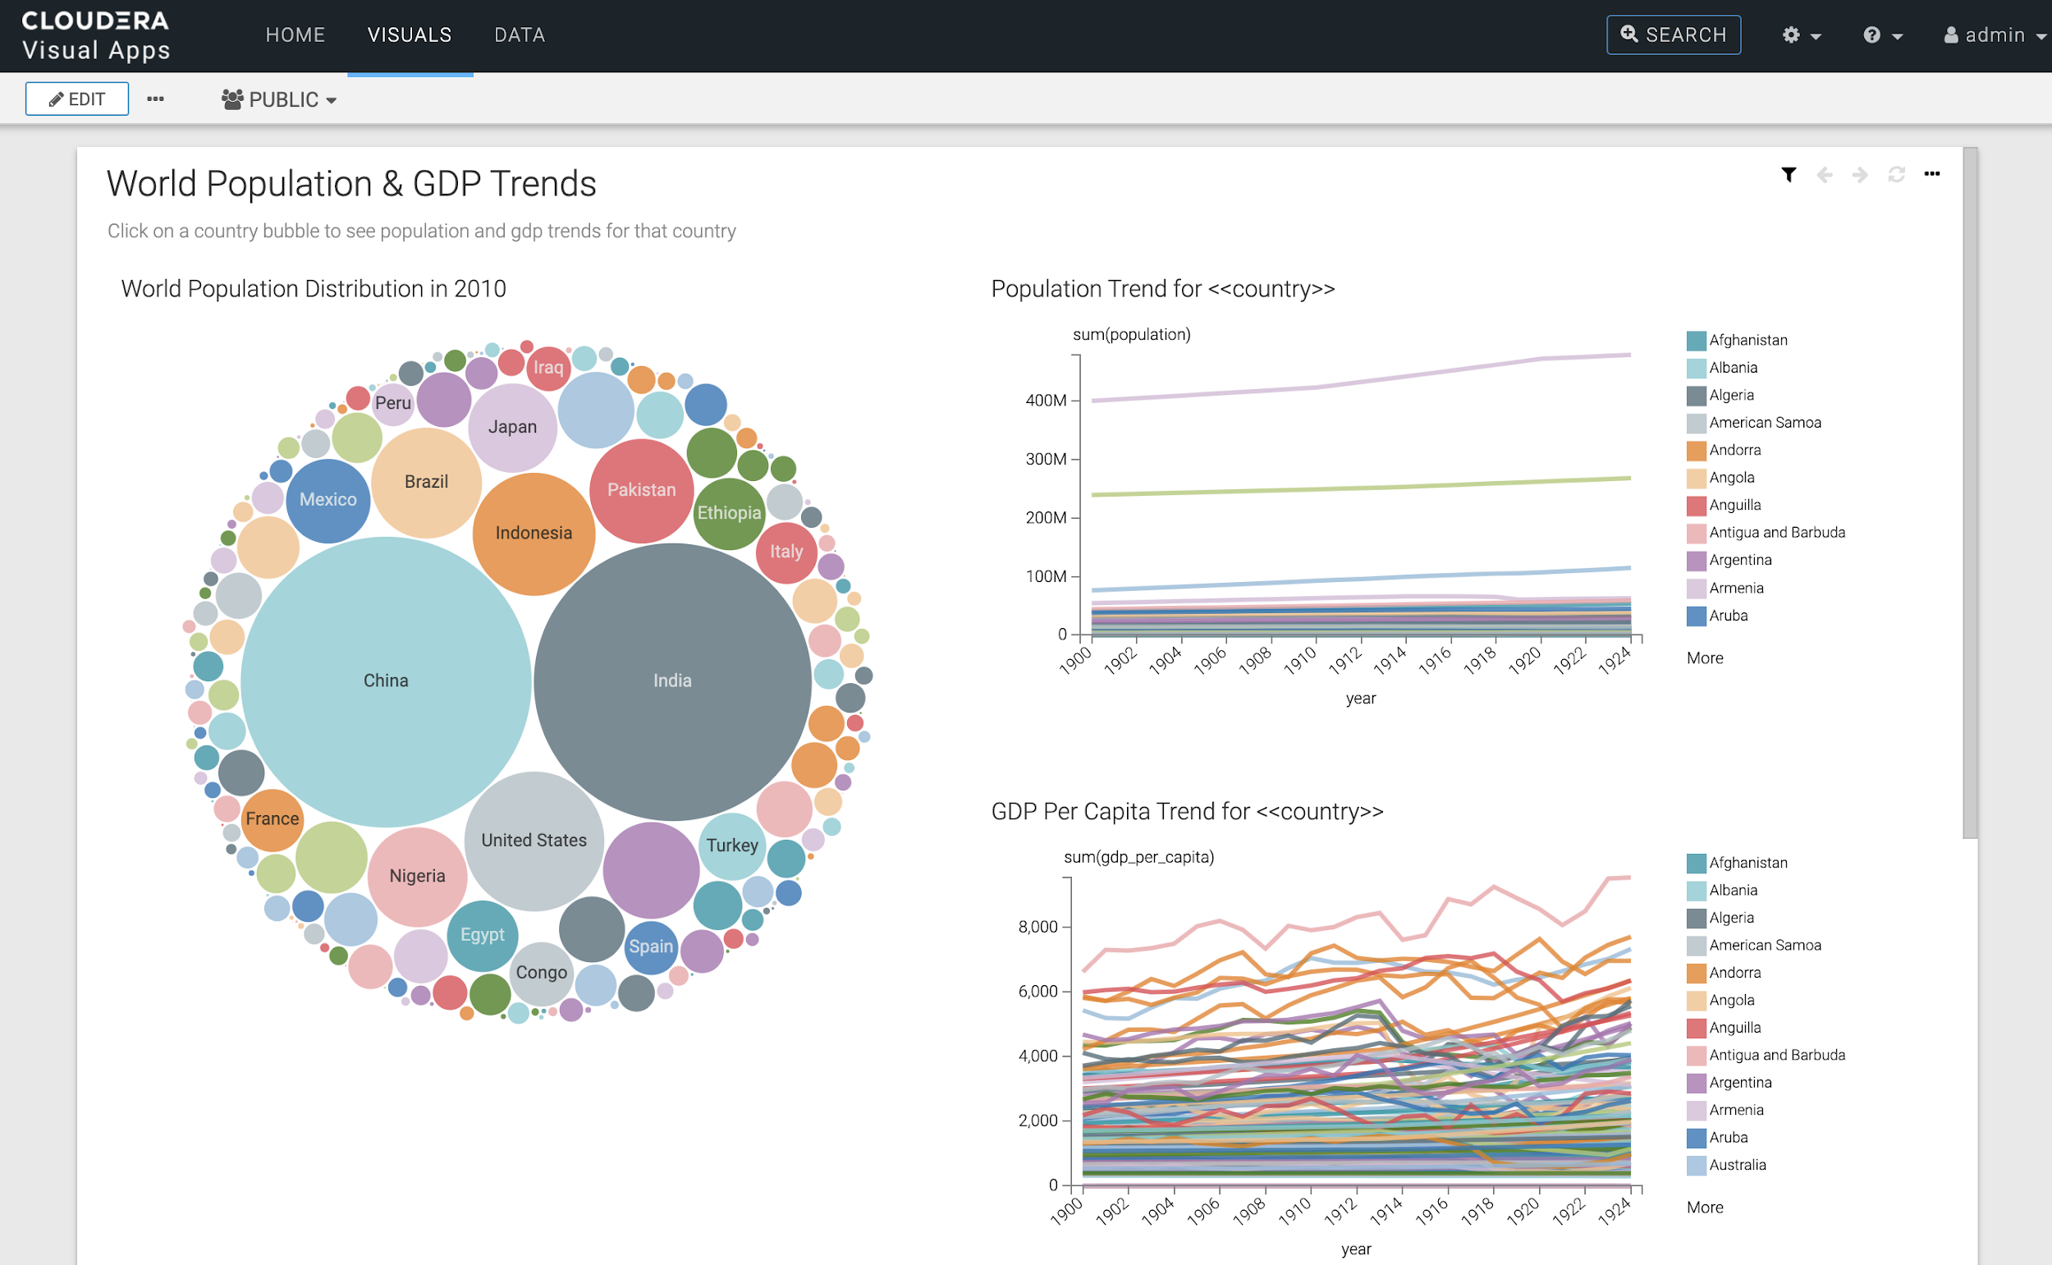
LAB 3 – COMPONENTS
CDW
CML
Real Time
Event Store
Real Time
Data Mart
Data Discovery & Exploration
Data Stream Analytics
(Coming soon)
Predictive
Models
Data
Science

Slide 41
LAB 3 – COMPONENTS
BI Tools
Ad Hoc SQL
Data Science
Machine Learning
Streaming Analytics
Powerful engines for multifunction analytics
Metadata | Schema | Migration | Security | Governance
Security, Governance, Metadata, Performance
Open Table Format - Iceberg Tables
Open Table Format - Hive ACID Tables
Structured Transaction Layer
File Formats
Parquet | AVRO | ORC | JSON
Storage
HDFS | Ozone | AWS S3 | Azure ADLS Gen 2 | Google Cloud Storage | AliCloud OSS
Data lake for all your data, wherever you run
* JSON is not supported by iceberg
Notes:
sdx integration
multiple engines
multiple file formats
Iceberg uses metastore:
list tables
internal implementation: locking for write operation

Slide 42
LAB
4

Slide 43
ANALYTICS ACROSS THE DATA LIFECYCLE
DATA ENGINEERING
MACHINE LEARNING
INGEST
ANALYZE
PUBLISH
02
04
01
03
05
PREPARE
PREDICT
DATA FLOW
DATA
WAREHOUSE
DATA VISUALIZATION
SECURITY | GOVERNANCE | LINEAGE | MANAGEMENT | AUTOMATION

Slide 44
LAB 4 – OVERVIEW
CML tour
Train a ML model to predict customer churn
Deploy the trained model for real time scoring/prediction
Deploy web application

Slide 45
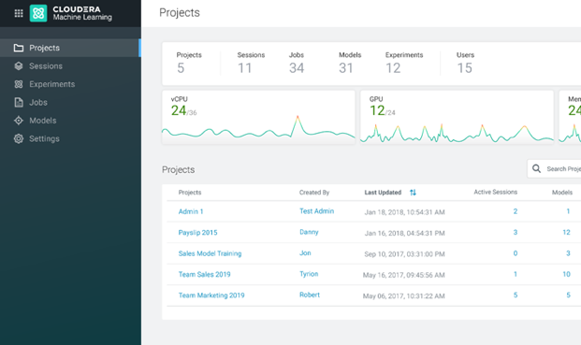
MACHINE LEARNING
ML Workspaces for teams without waiting
Self-service governed data access
Data scientists’ preferred, open tools
Elastic, auto-suspending resources
Comprehensive, cohesive UX for end-to-end ML including DE
Portable and consistent

Slide 46
CML and Model Lifecycle
CML follows the 3 phases of the ML lifecycle
Exploratory Data Science
ML Development
Production ML
Data Engineering Pipelines
Data Science
Model Training
Packaging & Deployment
Serving
Production Env.
Monitoring
Closed Loop ML
Guide & Flexibility
Choice & Government

Slide 47
Engine vs Runtime architecture
Guide & Flexibility
Workbench
Spark
JupyterLab
Python libs
JupyterLab
Jupyter
Python libs
Python 3.6
Python libs
Workbench
Python 3.6
Ubuntu image
Python 3.7
R libs
Ubuntu image
Ubuntu image
Framework
Python libs
Editor
Scala
Workbench
Edition
R 3.6
Workbench
R libs
RStudio
Kernel
Scala
R 4.0
OS
Python 3.6
R 3.6
R libs
Python 2.7
Ubuntu image
Ubuntu image
R 3.6
Ubuntu image
Ubuntu image
Spark
Engine (~10 Gb)
Runtimes
(<1Gb each)

Slide 48

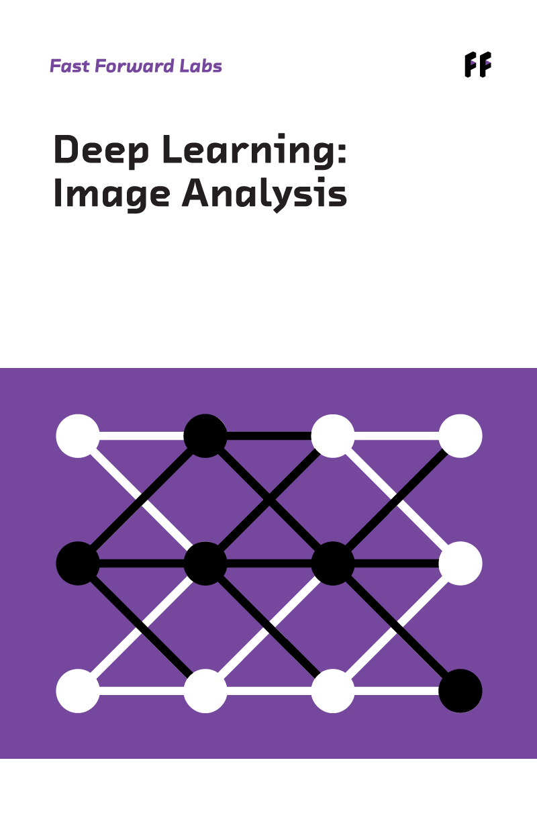
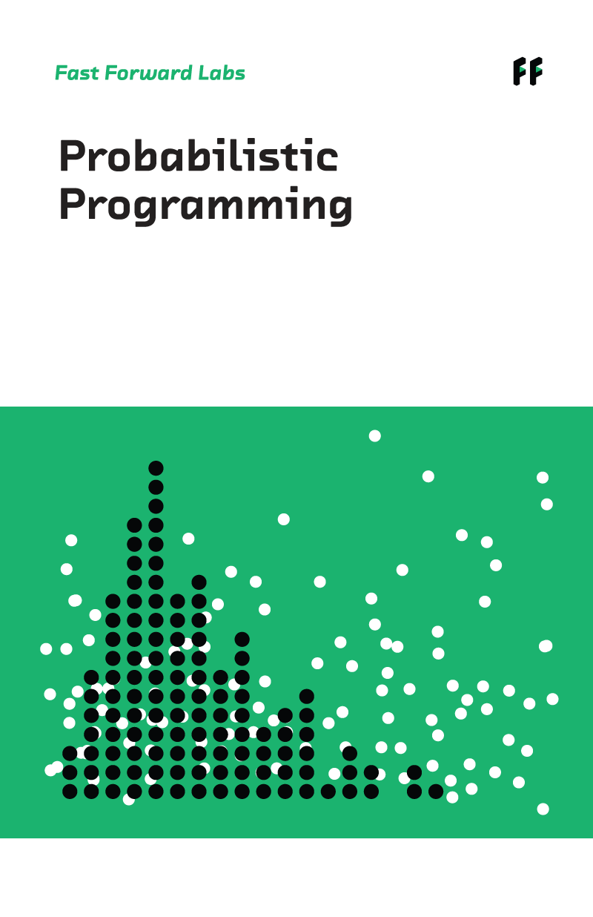
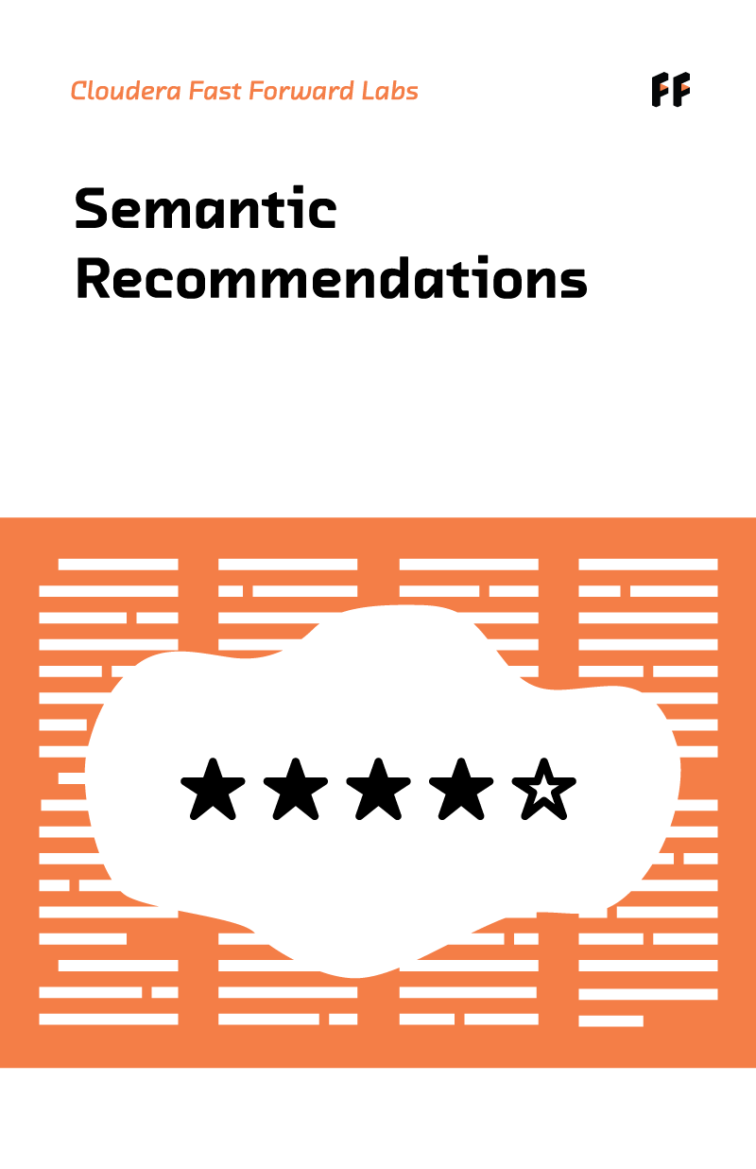
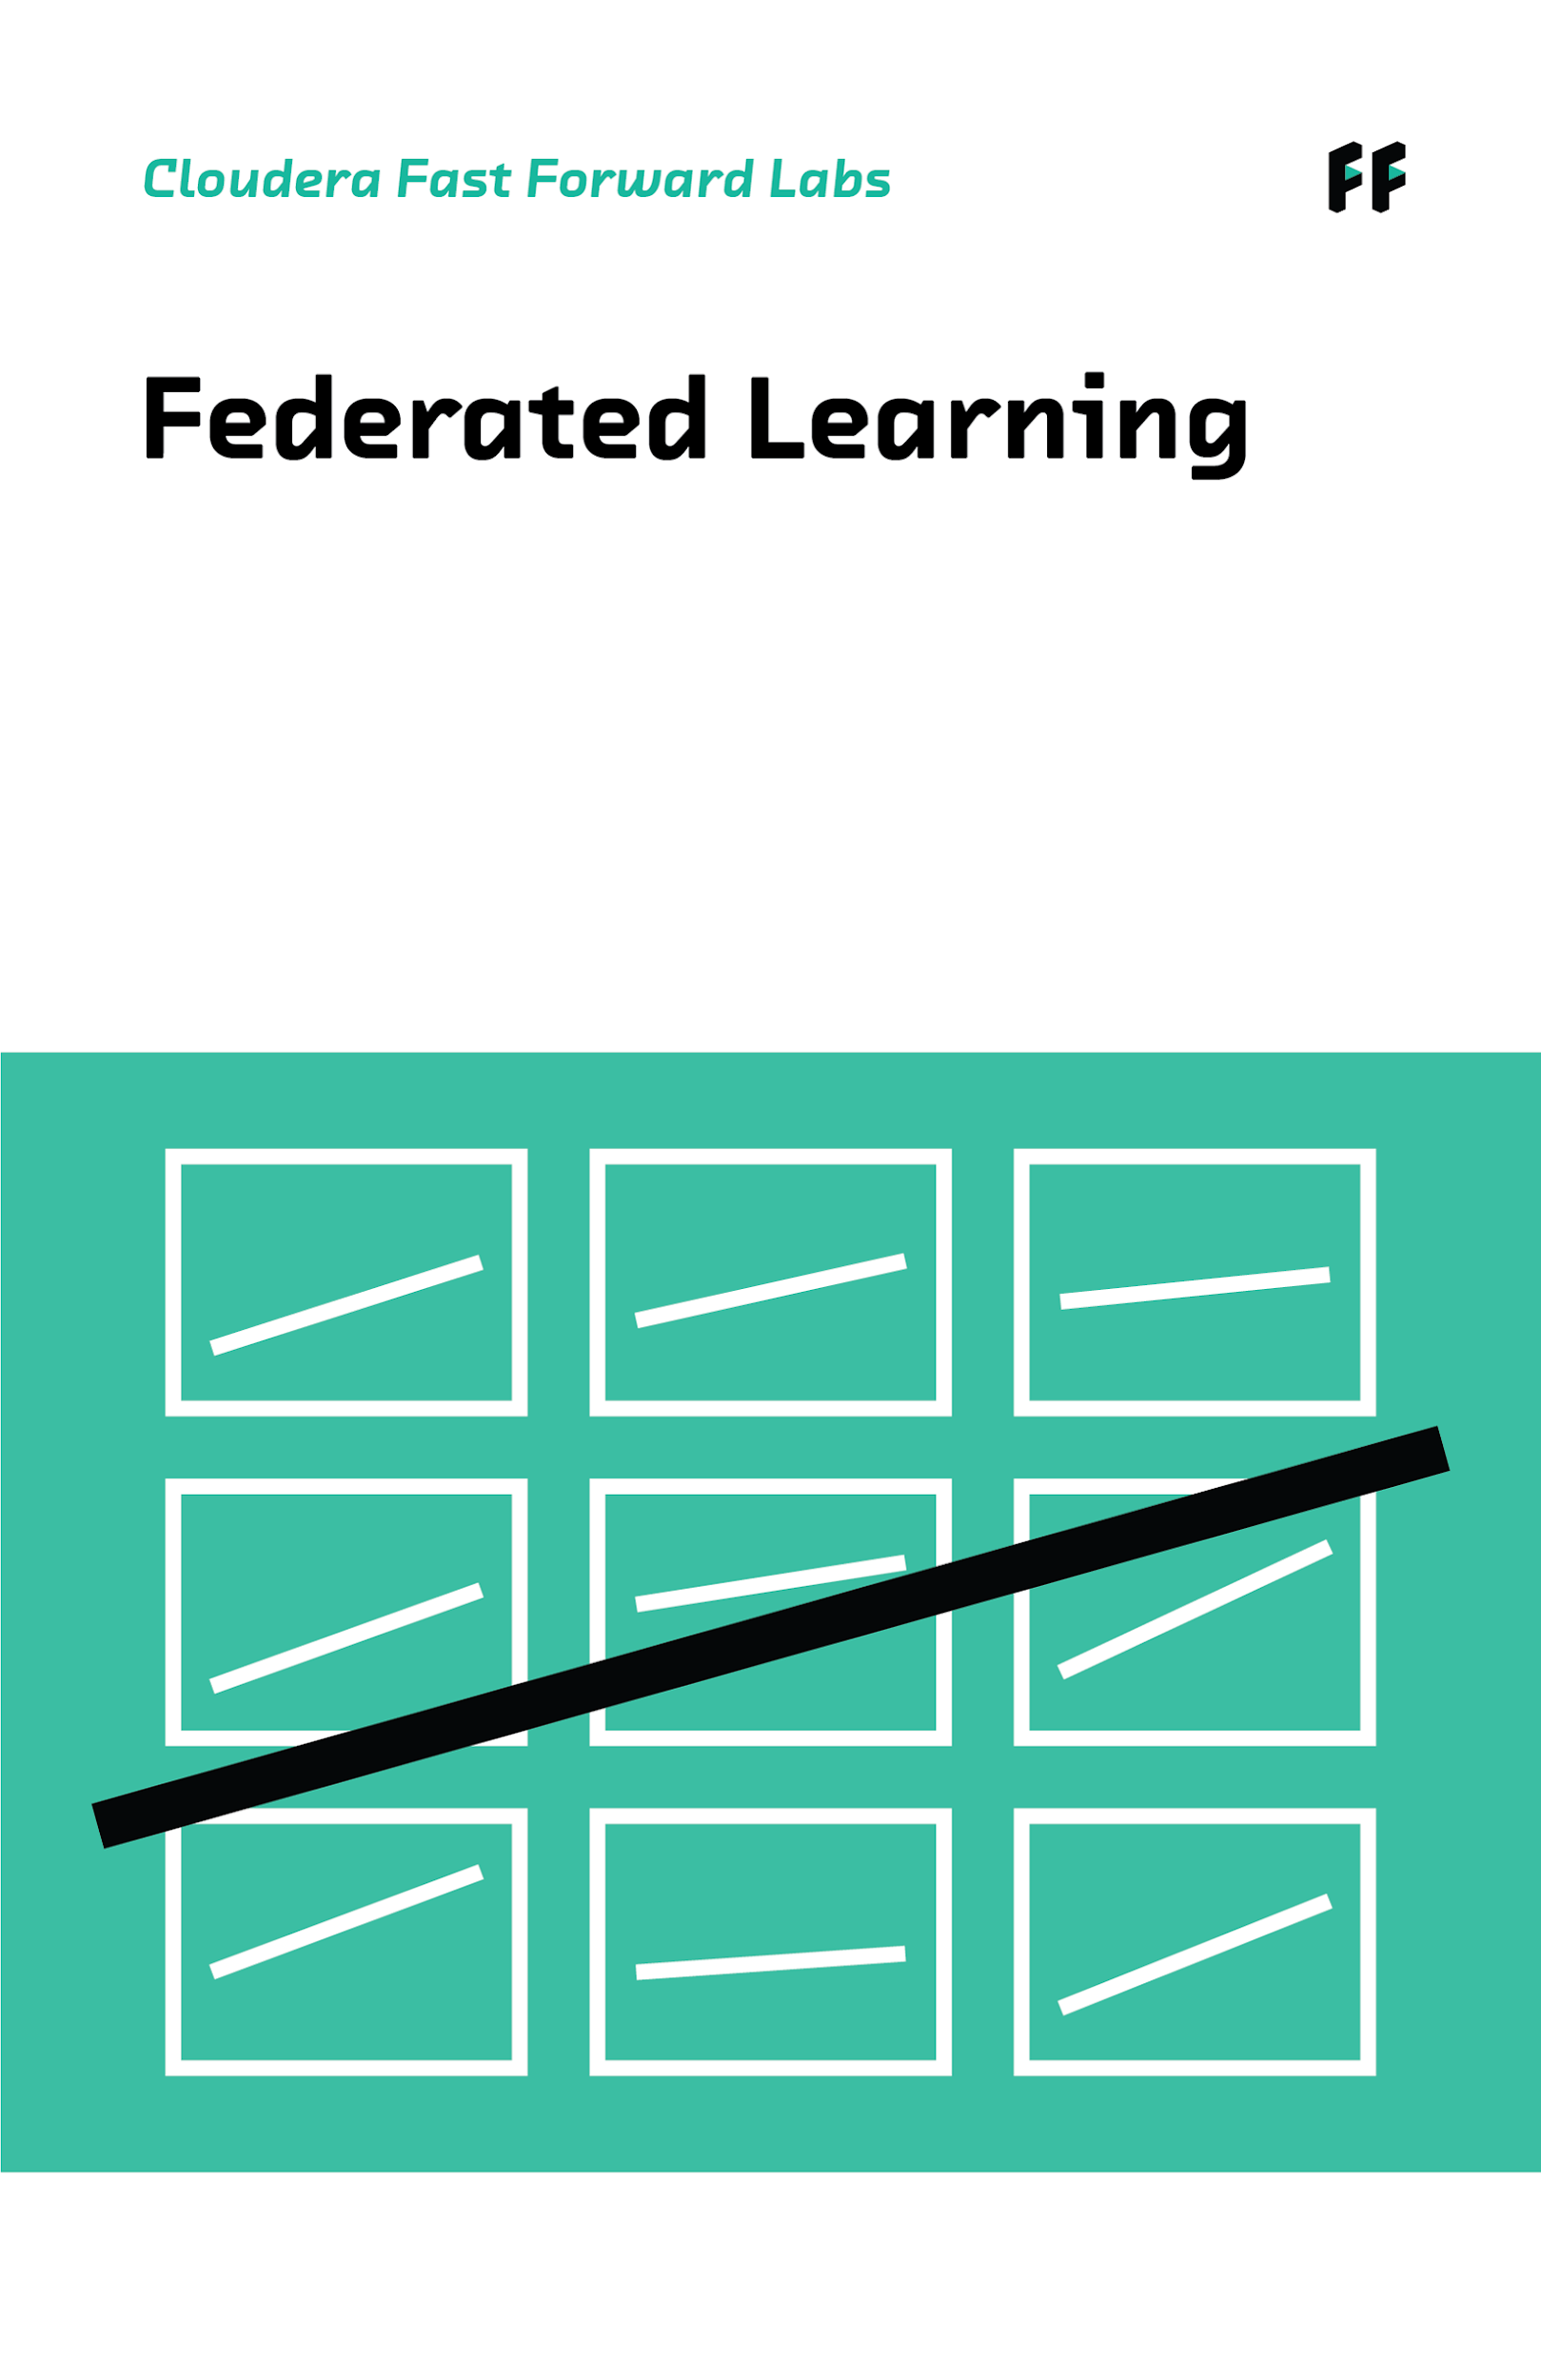


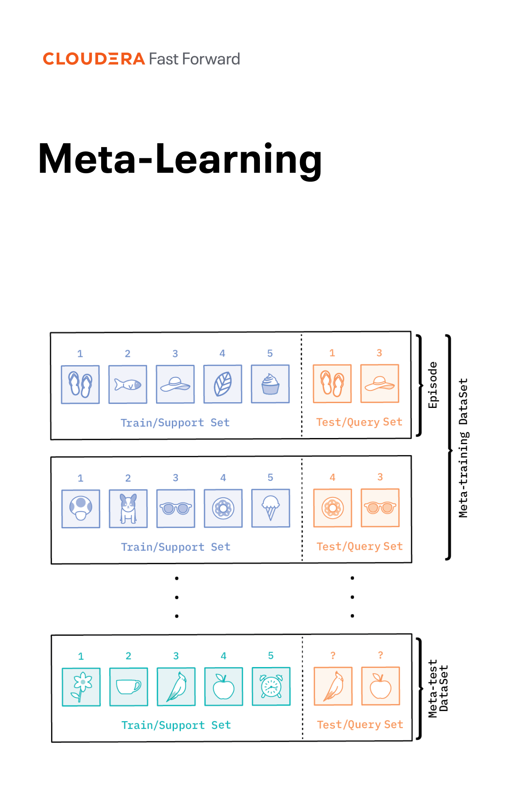
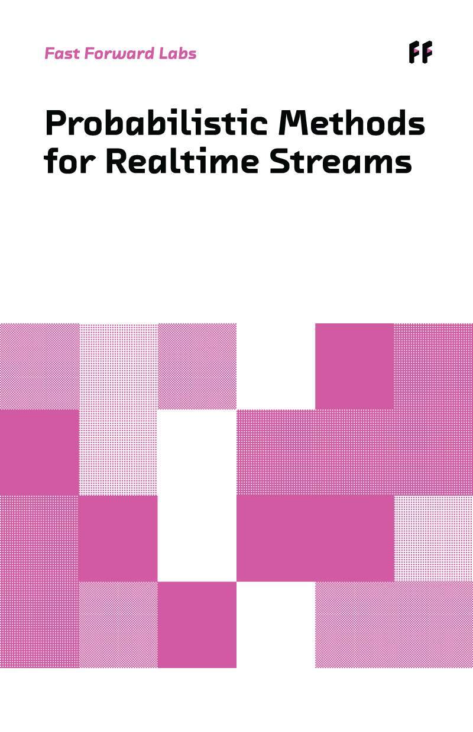
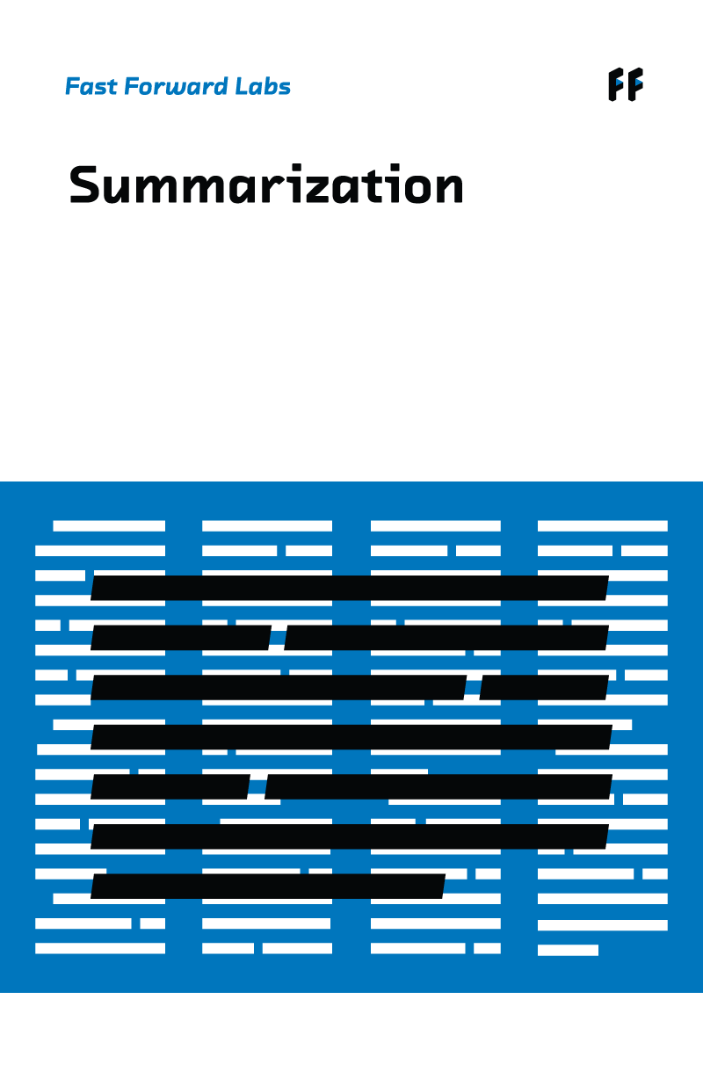

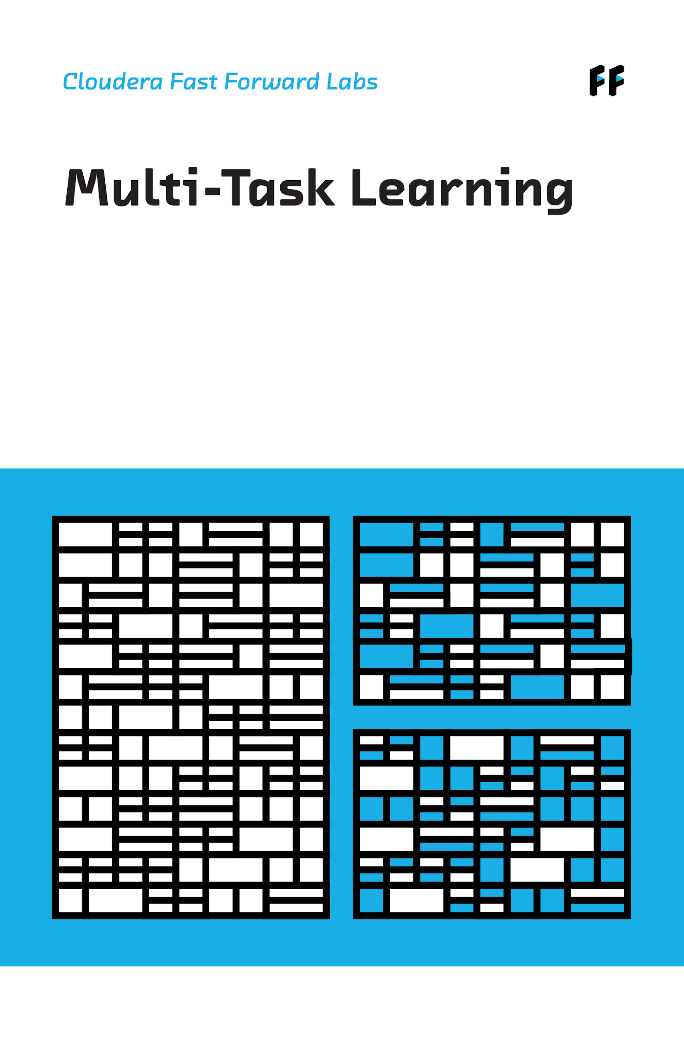
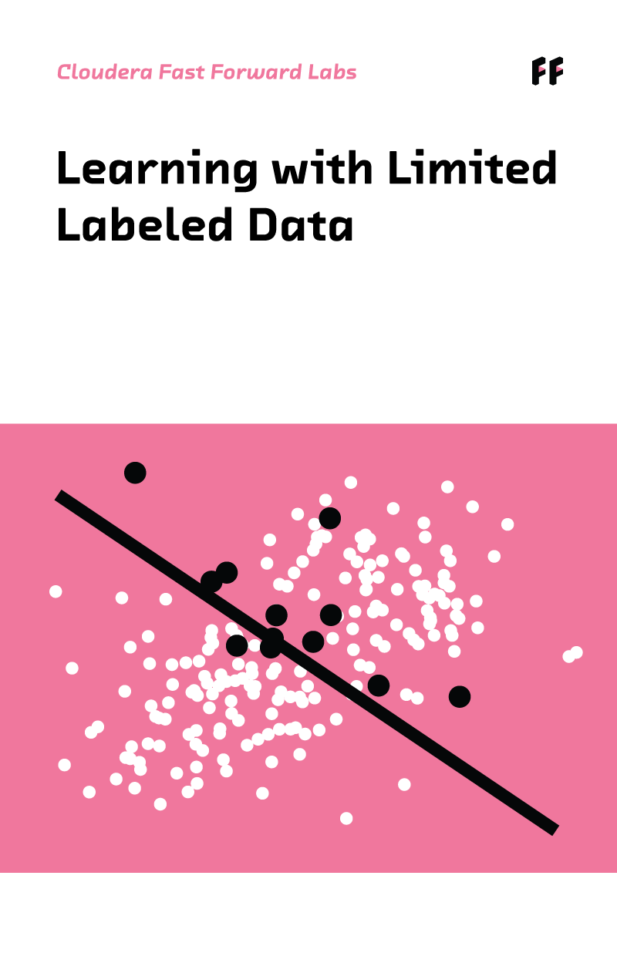

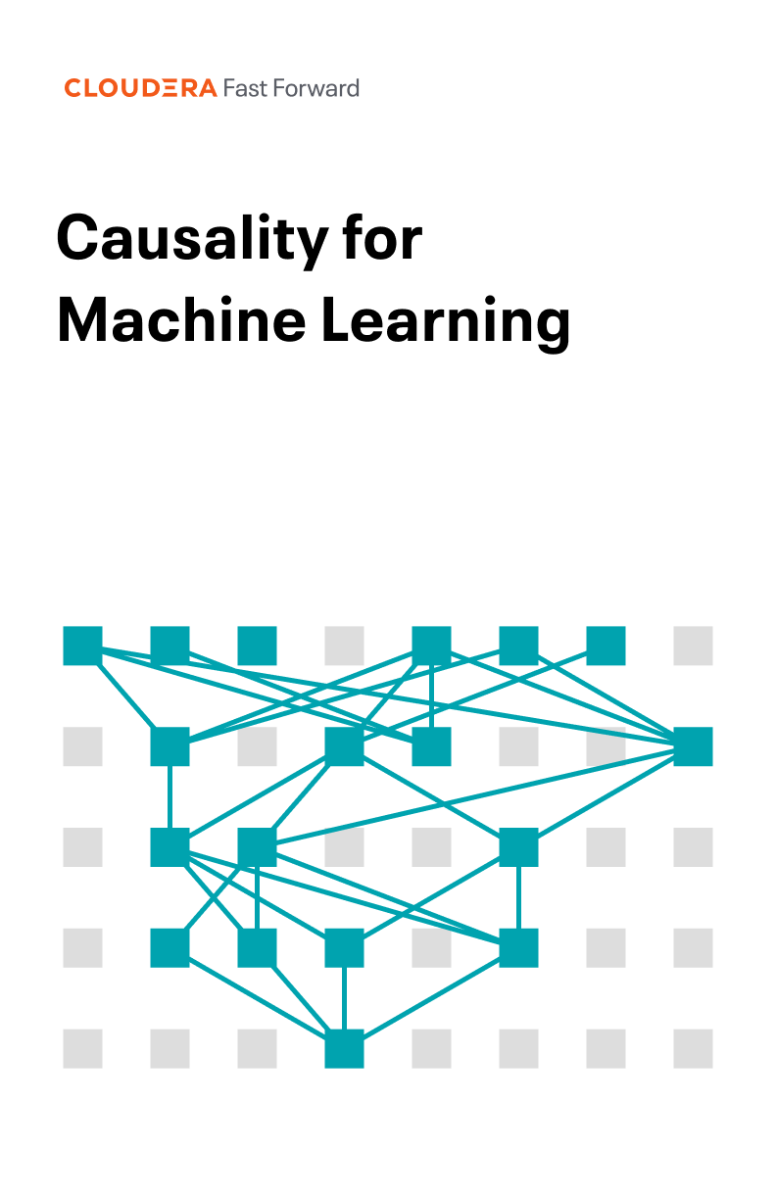
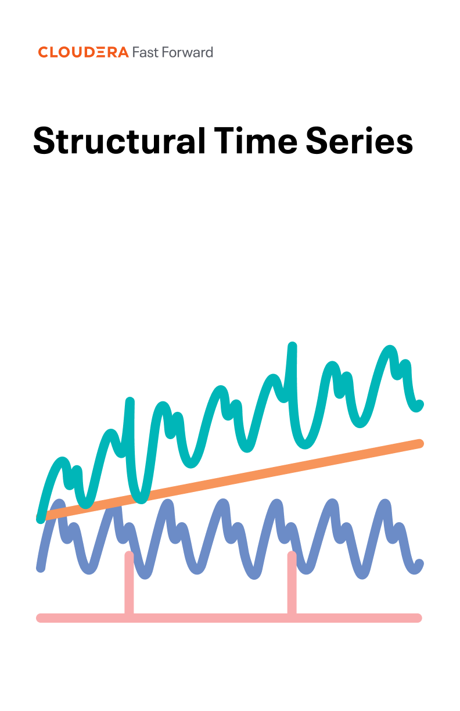
AMPs Seeded with Applied ML Research from Cloudera Fast Forward
Guide & Flexibility
Preview all of our research here

Slide 49
MLOps – Model Governance
Choice & Government
Functional requirements
Repository
Registry of the models, versions, when it was deployed, data dependencies, how to run it…
Deploy
Get easily insights from the model in production, without re-writing the model
Monitorization
Getting the behaviour of the model according with defined business and statistical metrics with a certain periodicity
Automatization
The automatic accomplishment of the previous requirements would lead to a robust mlops methodology but with capability of define different strategies for the different projects

Slide 50



ML OPS WORKFLOW
Choice & Government
CML/CDSW
Model Request
{key, value}
Business Systems
track_metric
Model
Model Metrics Store
Model Response
{key, value}
Replica
read_metrics
met_1 | met_2 | pred | actual | acc
321 | blue | 0 | 0 | -
4521 | orange | 1 | 1 | -
9472 | blue | 1 | 1 | -
56 | purple | 1 | 0 | -
- | - | - | - | .67
Session
CML UI
track_delayed_metric
track_aggergate_metrics
read_metrics
Job
CML UI
Train Model
Operational Systems
SDK
Other Models
Notes:
Once our models are built and deployed
We want to be able to measure model degradation to ensure they continue to produce
positive outcomes
ROI
So model monitoring capabilities are built into the platform
When a consuming process makes a request to the model,
the response contains a unique identifier for the model deployed
as well as for the request
At the point of inference we don’t know the ground truth
So if you take for example a consumer lending application
where we are underwriting mortgages or were underwriting CC applications
we don’t know at the point of inference
that that CC application will result in a default
We can only ground truth the point inference operations some time after the fact,
perhaps a few months or even years
So built into the API is the ability to update
delayed metrics such as ground truth
These can then be used to track model degradation
We can leverage native capabilities within CML
to monitor for out of tolerance model performance
and automate model retraining
from within CML
But, we can also leverage CICD tooling
to kick off retraining jobs within CML
Through use of the CML API

Slide 51



EMPOWER BUSINESS TEAMS TO TAKE ACTION WITH DATA
Seamlessly Collaborate Across The Lifecycle To Deliver Analytical Insights Fast
BUSINESS TEAMS &
DECISION MAKERS
DATA / BUSINESS ANALYSTS
Communicate & collaborate effectively across the data lifecycle
Prepare, store, manage & deliver datasets to products & services
Ad-hoc visual exploration & analysis
Make informed business decisions accurately
Data Visualization
Create, publish and share interactive data visualizations

Slide 52
WRAP
UP

Slide 53
SOLUTION DESIGN TO ANALYZE & PREDICT TELCO CHURN
INGEST
PREPARE
PREPARE
Ingest from Kafka, store in S3 using Parquet in the Open Lakehouse
Orchestrate jobs to enrich data and update table
Train and deploy ML model to predict telco churn
Telco Customer Data collected in Kafka
ANALYZE
PUBLISH
Query data from Open Lakehouse
Build a dashboard/ visual analytics
SECURITY | GOVERNANCE | LINEAGE | MANAGEMENT | AUTOMATION

Slide 54



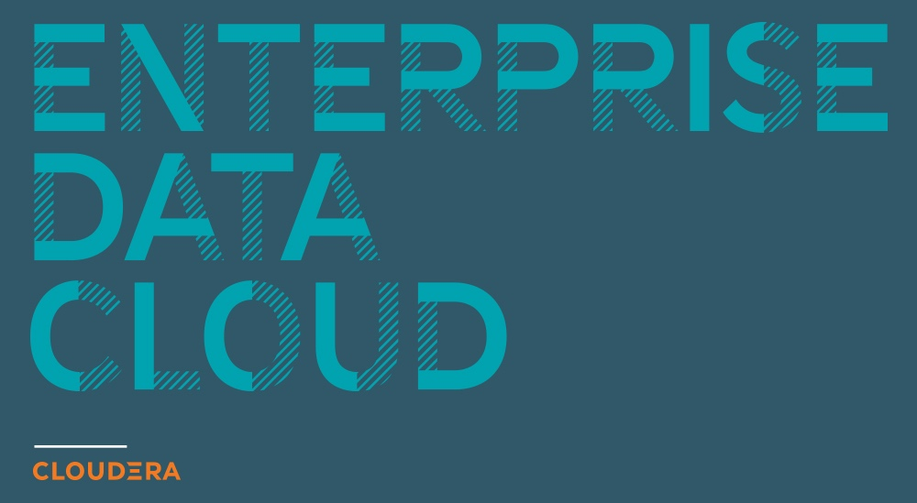


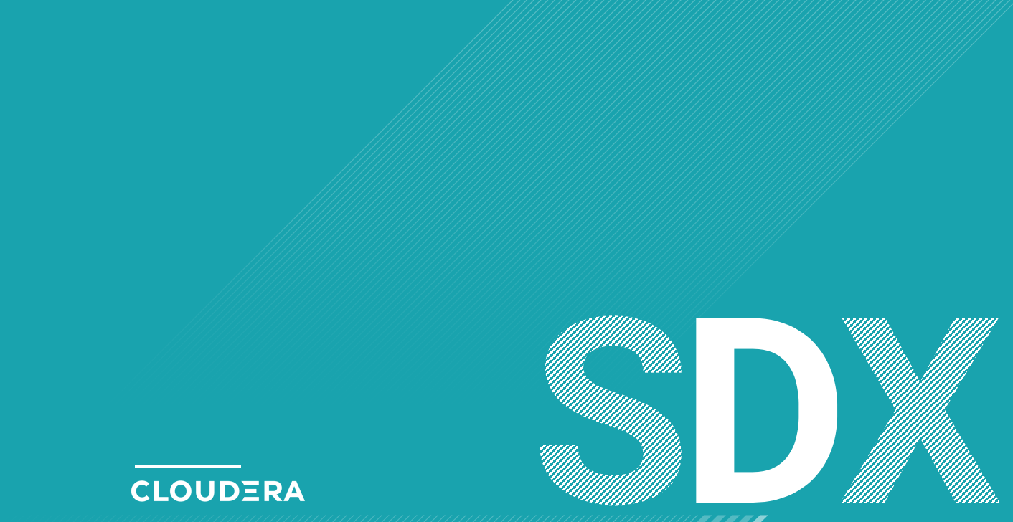


Slide 55


Data Lifecycle

